Slide 1
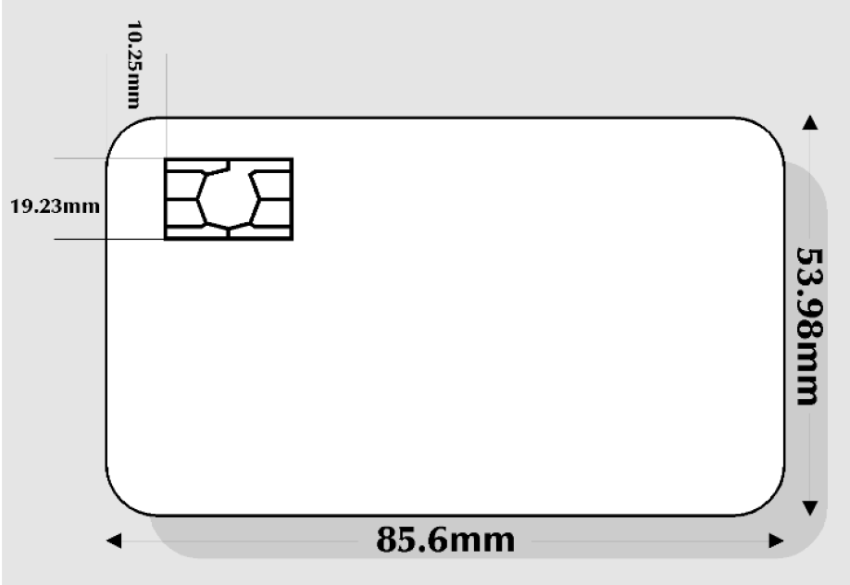

Slide 2
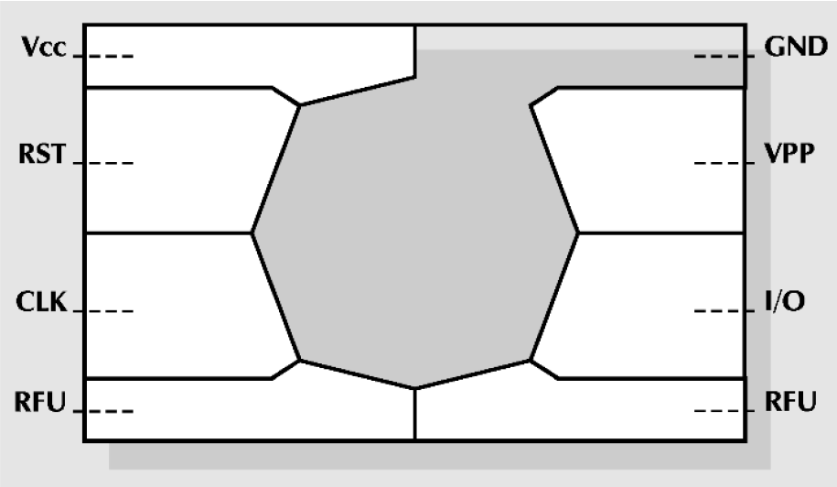

Slide 3
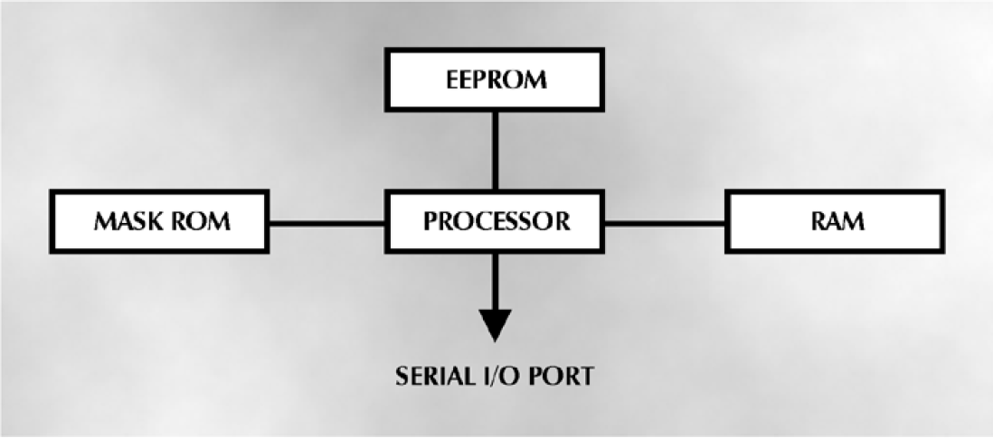

Slide 4
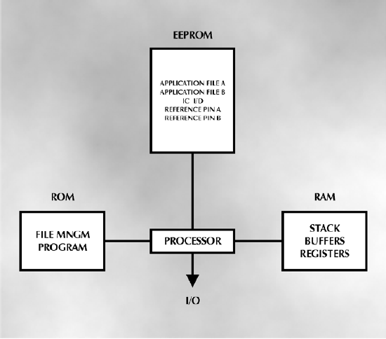

Slide 5
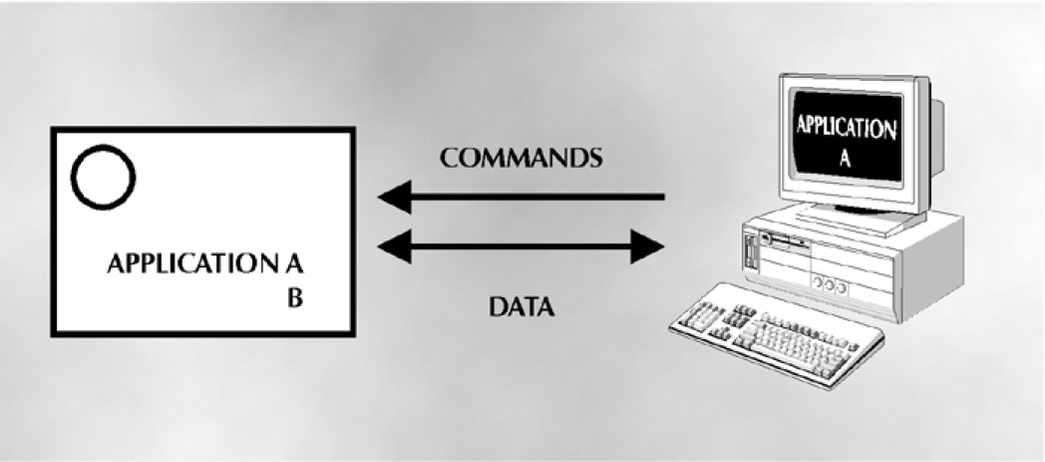

Slide 6
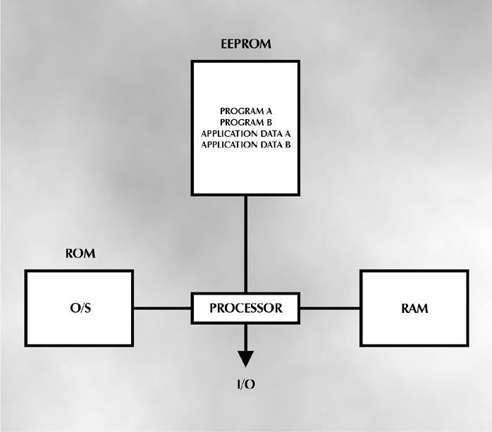

Slide 7
An Embedded System is a system that has embedded software in a computer hardware.

Slide 8
The system is
dedicated for an
application(s)
or
Video/audio
players

Slide 9
The system is
dedicated for a
specific part
of an application(s)
or
Image processing

Slide 10
The system is
dedicated for a
product
or
Smart Cards

Slide 11
The system is
dedicated for a
component of a
large system
Automotive Electronics

Slide 12
An Embedded System is any device that includes a programmable computer

Slide 13
An Embedded System is not itself intended to be a general purpose computer
fax machine

